Slide 1
Understanding Web Sockets
André Masson
Octobre 2022

Slide 2
What’s included in this full stack project
Backend (Node.js)
Remember each connected socket
Handling incoming messages
Broadcasting (message response) to registered sockets
Frontend (React + Material-UI)
Register a unique socket (user based)
Handle socket open / close events with reconnect mechanism
Sending and receiving messages
Language : Typescript

Slide 3
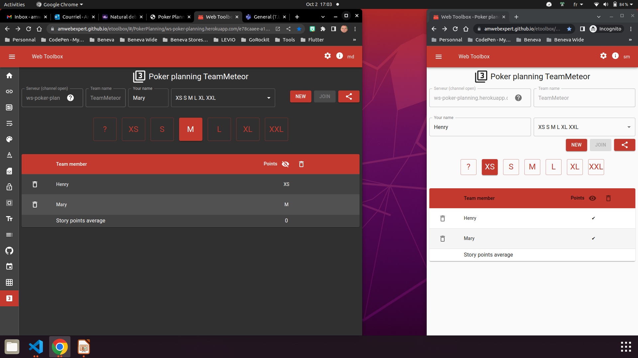

Slide 4
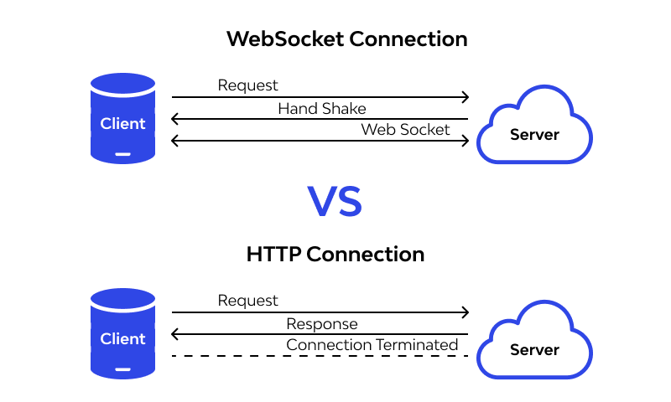
Comparing to http protocol

Slide 5
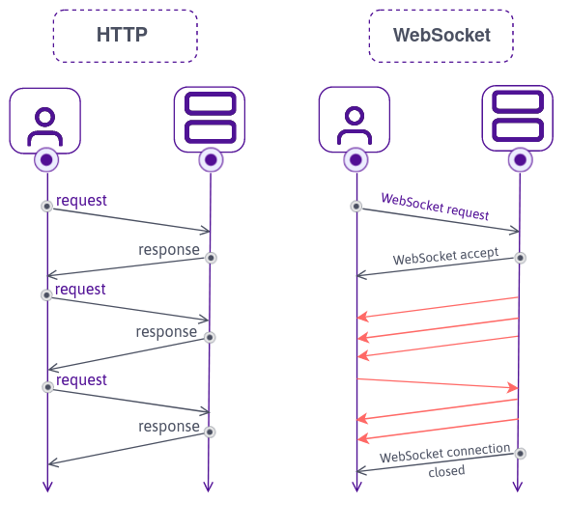
HTTP agnostic nature needs auth headers

Slide 6
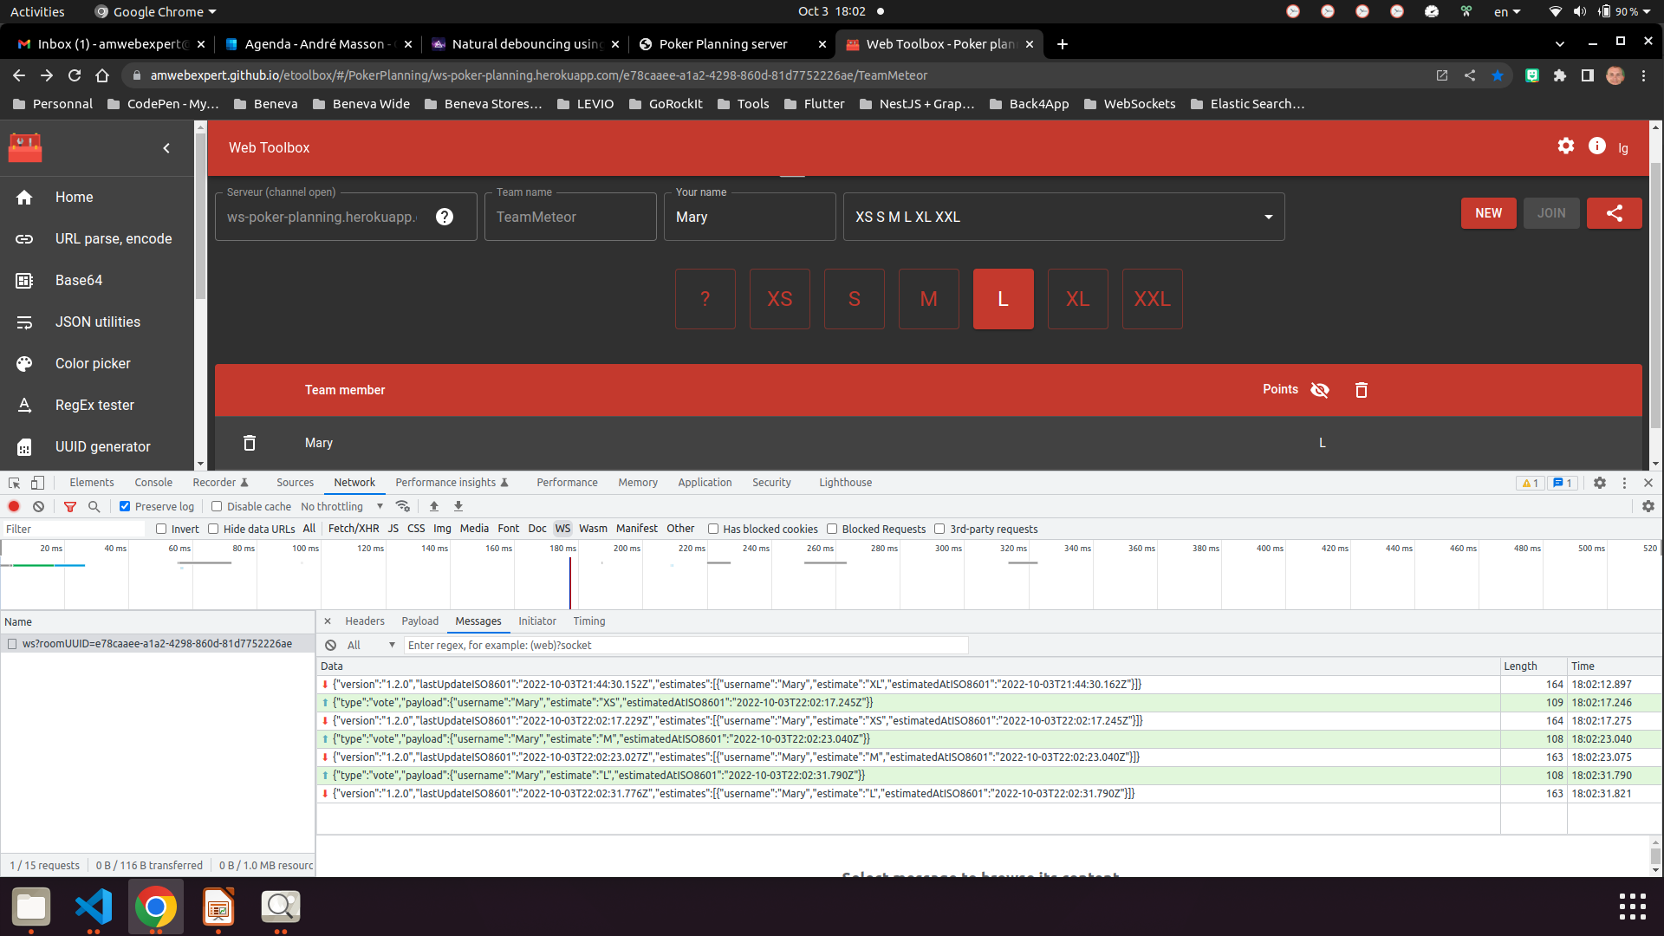
A web socket is likely to close after a delay

Slide 7
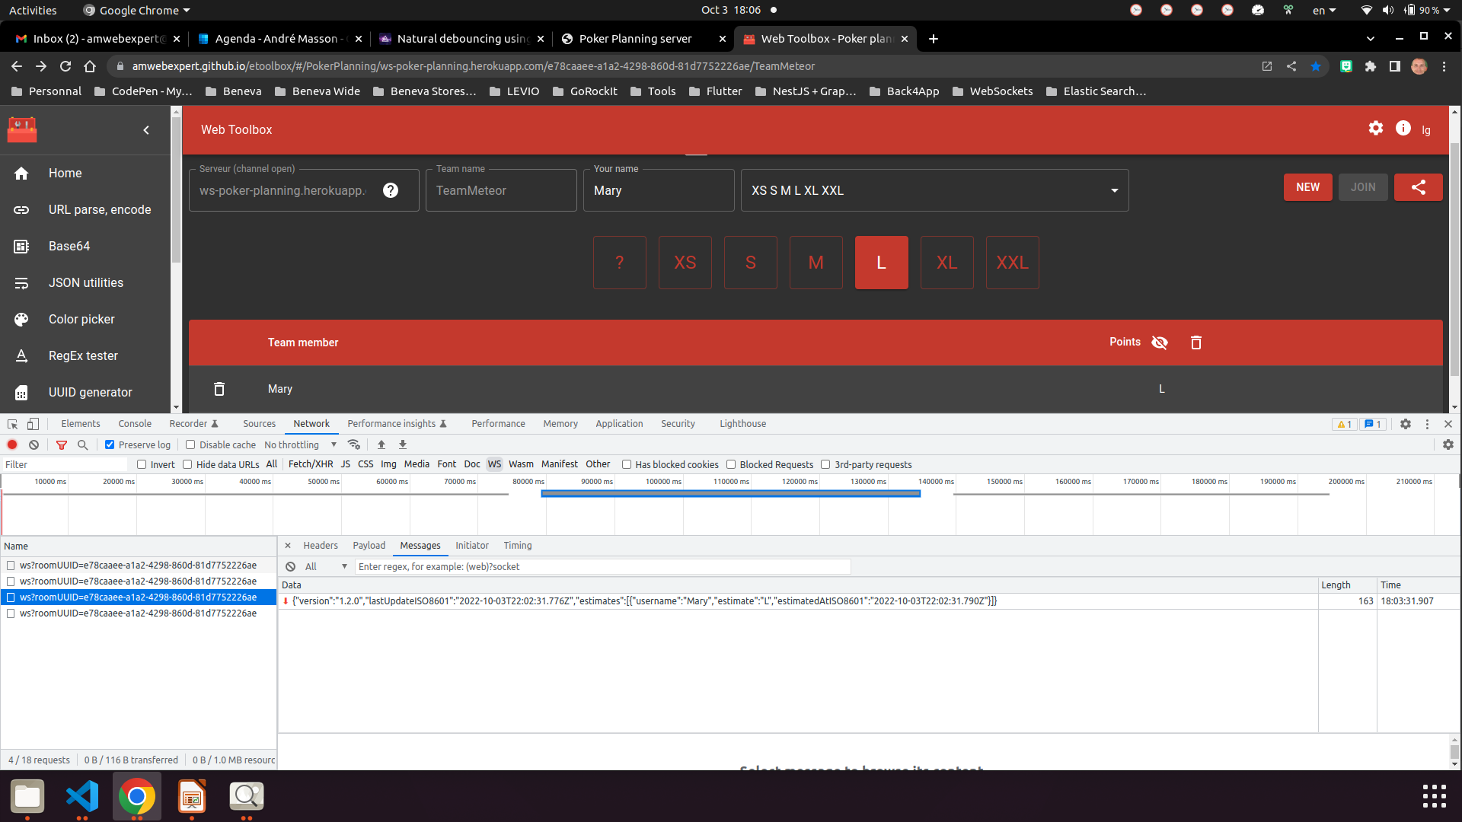
A web socket will close after a delay

Slide 8
More to come...

Slide 9
References
Web socket server GitHub repository
https://github.com/amwebexpert/ws-poker-planning
Web socket client GitHub repository
https://github.com/amwebexpert/etoolbox

